Slide 1

Micro Processors & Interfacing
16CS307
Mr. M Krishna Chennakesava Rao,
Asst. Professor, Dept. of ECE,
VFSTR University

Slide 2
Interrupts of 8086
The meaning of ‘interrupts’ is to break the sequence of operation.
While the CPU is executing a program, on ‘interrupt’ , breaks the normal
sequence of execution of instructions, diverts its execution to some other
program called Interrupt Service Routine (ISR).
After executing ISR , the control is transferred back again to the main program.
An 8086 interrupt can come from any of the 3 sources.
External signal applied from INTR / NMI ( Hardware Interrupts)
Interrupt Instruction ( INT N) ( Software Interrupts)
Some error condition produced in 8086 by the execution of an instruction.
( Divide an operand by 0)
In 8086 system, the 1st 1KB of memory 00000H to 003FC H is set as table
for storing the starting address of ISR.
Starting address of ISR, is called as Interrupt vector or interrupt pointer. Hence the
table is called as Interrupt vector table or interrupt pointer table .

Slide 3
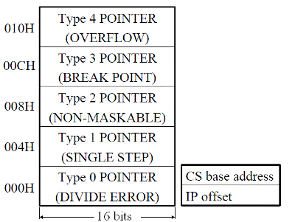
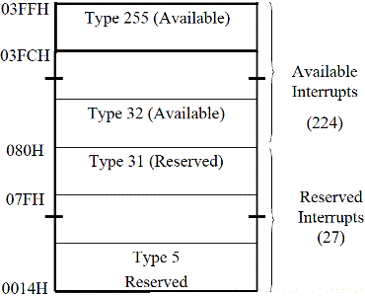
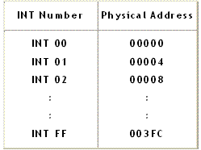
Interrupt vector table

Slide 4
Interrupts of 8086 cont’d…
Types of Interrupts: There are two types of Interrupts in 8086.
Hardware Interrupts (ii) Software Interrupts
i. Hardware Interrupts ( External Interrupts ).
The Intel microprocessors support hardware interrupts through:
two pins that allow interrupt requests, INTR (pin 18) and
NMI (pin 17) .
One pin that acknowledges, INTA (pin 24), the interrupt requested
on INTR.

Slide 5
Hardware and Software Interrupts
The nonmaskable interrupt is generated by en external device, trough a rising edge on the NMI pin.
Cannot be ignored by the microprocessor.
Generates a Type 2 interrupt (address 0008H in the Interrupt vector table)
The maskable interrupts (00…FFH) can be generated by:
an external device, trough a high logic level on the INTR pin (the external device has to specify the interrupt number).
Hardware
interrupts
(IF (interrupt flag) in FLAGS register enables or disables (masks) the μP to accept maskable interrupts.)
microprocessor itself (i.e. when trying to divide by 0), (the interrupt number is hardware defined).
Software interrupts (exceptions) using the INT instruction (followed by the interrupt number (type)).
Interrupt priority
Divide-error Highest
INT, INTO
NMI
INTR
Single-step Lowest

Slide 6
Hardware Interrupts of 8086 cont’d…
INTR
INTR is a maskable hardware interrupt.
The interrupt can be enabled/disabled using STI/CLI instructions
(or)
using more complicated method of updating the FLAGS register with the
help of the POPF instruction.
When an interrupt occurs, the processor
stores FLAGS register into stack,
disables further interrupts,
fetches one byte (00 H to FF H) representing interrupt type,
and jumps to interrupt processing routine address of which is stored in
location 4 * <interrupt type>.
Interrupt processing routine should return with the IRET instruction.

Slide 7
Hardware Interrupts of 8086 cont’d…
NMI
NMI is a non-maskable interrupt.
This interrupt has higher priority than the maskable interrupt.
Interrupt is processed in the same way as the INTR interrupt.
Interrupt type of the NMI is 2,
i.e. the address of the NMI processing routine is stored in
location 0008 H Type N* 4.

Slide 8
Interrupts of 8086 cont’d…
(ii) Software Interrupts (Internal Interrupts and Instructions) .
Software interrupts can be caused by:
1. INT 03H instruction - breakpoint interrupt. This is a type 3 interrupt.
2. INT <interrupt Type N > instruction : -
any one interrupt from available 256 interrupts. ( 00 H to FF H).
When an INT N instruction is executed, Type byte N is multiplied with 4;
The content of IP & CS of ISR will be taken from the N*4 as OFFSET address and 0000 as segment address.
Ex: INT 20H;
Type N * 4 = 20H*4= 80H
So, ISR address is specified by 0000: 0080 H

Slide 9
Interrupts of 8086 cont’d…
(ii) Software Interrupts (Internal Interrupts and Instructions) .
3. INTO instruction - interrupt on overflow
4. Single-step interrupt – ( It executes one instruction & stop)
generated if the TF flag is set.
This is a type 1 interrupt.
When the CPU processes this interrupt it clears TF flag , before calling
the interrupt processing routine.
Processor exceptions: Divide Error (Type 0),
Unused Opcode (Type 6) and
Escape Opcode (Type 7).
Software interrupt processing is the same as for the hardware interrupts.
Ex: INT n (Software Instructions)

Slide 10
(ii) Software Interrupts
INT 00 (divide by zero error): -
INT 00 is invoked by the microprocessor whenever there is an attempt to
divide a number by zero.
ISR is responsible for displaying the message “Divide Error” on the screen
INT 01 (Single-step Interrupt): -
For single stepping the trap flag must be 1
After execution of each instruction, 8086 automatically jumps to 00004H to fetch
4 bytes for CS: IP of the ISR.
INT 02 (Non-Maskable Interrupt): -
Whenever NMI pin of the 8086 is activated by a high signal (5v),
The CPU Jumps to physical memory location 00008 to fetch CS: IP of the
ISR associated with NMI.

Slide 11
(ii) Software Interrupts
INT 03 (break point Interrupt): -
A break point is used to examine the CPU and memory after the execution
of a group of Instructions.
It is one byte instruction
whereas other instructions of the form “INT nn” are 2 byte instructions.
INT 04 (Signed number overflow Interrupt): -
There is an instruction associated with this INT 04 (interrupt on overflow).
If INT 04 is placed after a signed number arithmetic as IMUL or ADD
the CPU will activate INT 04 if 0F = 1.
In case where 0F = 0, the INT 04 is not executed but is bypassed and
acts as a NOP.

Slide 12
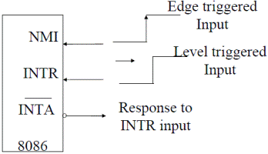
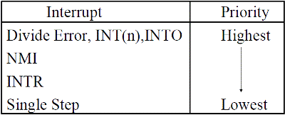
Performance of Hardware Interrupts: -

